Slide 1
CSS Introduction, Selectors, and Pseudo-Selectors
Week 2

Slide 2
First, Quick Recap on HTML

Slide 3
Quick HTML Review
<!doctype html>
<html>
<head></head>
<body>
<!-- this itself is a comment -->
<!-- your webpage content goes inside the body -->
<p>Welcome to WDD!</p>
<img src=”wdd.png” />
</body>
</html>
Notes:
Questions to ask:
Can someone give me an example of a pair of tag in the code?
How about a self closing tag?
Someone tell be about the <head> tag — what makes it different from the rest?
What’s an example of what would go in there?
What are the two grayed out comments? What do they mean???? (lmao)
*Note: Tags define an HTML element, and I will use them somewhat interchangeably

Slide 4
What is an html tag?
Contains everything of a webpage
There should only be one of this in the entire file
<html> </html>
Don't forget about the <!doctype html> before <html>
Notes:
A <head> tag is a tag that contains within it a bunch of different kinds of information that the webpage visitor won’t see on the page itself:
One important thing that we add in the <head> of a page is the page title. We don’t mean the title that appears on the top of the webpage itself. We mean the bit of text that appears at the top bar of your browser window or tab. In this presentation, the browser window shows the title “Week 1 - Programming”. We can specify a title for a webpage different from anything on the page itself, and we use the <title></title> tag within <head> to do so.
<head> also contains references to what CSS and JavaScript files belong on the page, and other metadata like authors, publication date, and languages (human languages) used on the page. These don’t show up on the page, but help browsers make better sense of the webpage content.

Slide 5
What is a head tag?
User does not see what is here
Sets up the page
Title (on tab) of page
Links to important resources
CSS and JS files
Fonts
Author(s) of webpage
Other metadata
Sits inside <html></html>
<head> </head>
Notes:
A <head> tag is a tag that contains within it a bunch of different kinds of information that the webpage visitor won’t see on the page itself:
One important thing that we add in the <head> of a page is the page title. We don’t mean the title that appears on the top of the webpage itself. We mean the bit of text that appears at the top bar of your browser window or tab. In this presentation, the browser window shows the title “Week 1 - Programming”. We can specify a title for a webpage different from anything on the page itself, and we use the <title></title> tag within <head> to do so.
<head> also contains references to what CSS and JavaScript files belong on the page, and other metadata like authors, publication date, and languages (human languages) used on the page. These don’t show up on the page, but help browsers make better sense of the webpage content.

Slide 6
What is a body tag?
User does see what is here
All the webpage content
Words and text
Images
Also sits inside <html></html>
<body> </body>
Notes:
In contrast to the <head> tag, the <body> tag contains everything that shows up on the page, like headers, images, buttons, and input fields. Everything that you see on a webpage when you load it up sits inside a pair of <body> tags </body>.

Slide 7
Now that we've learned about HTML
How do we organize our project workspace?
(The following may/may not apply to industry standards)
Notes:
We’re briefly going to talk about the idea of structuring a project “workspace”.
Workspace is just a fancy word for the collection of all the files and code that comprise a website. Complex websites with many webpages can grow to have too many files for CSS, JS, and HTML to just keep all in one big folder, so it’s good to have some organization.
The way we’ll show here is specific to WDD and our class, but it’s also quite common, and a good starting point for more complex setups.

Slide 8
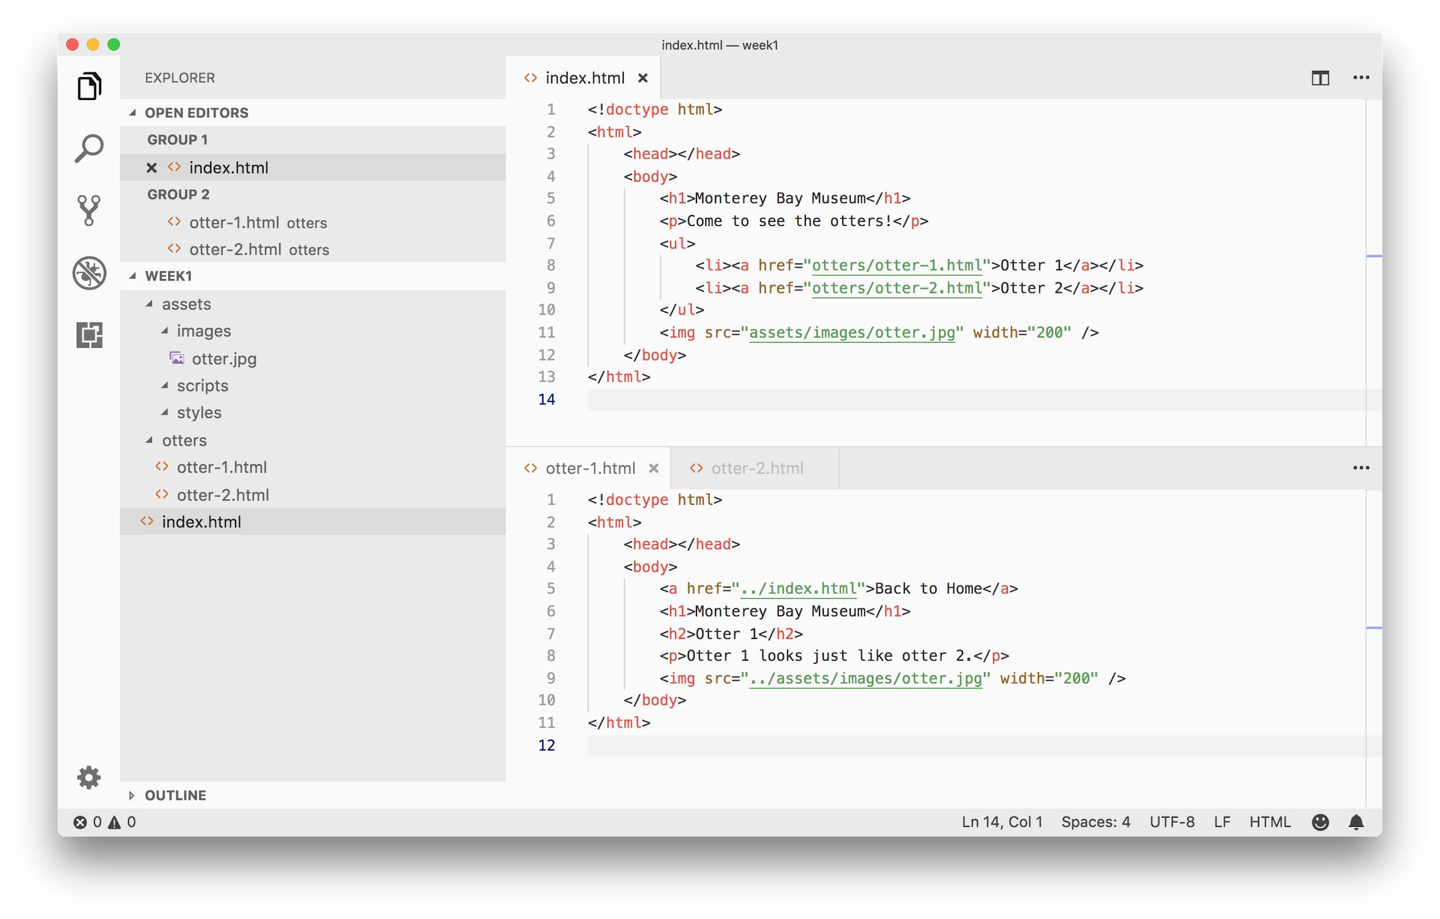
Example project (follow link to view/download)
Notes:
Here’s an example project with three webpages, index.html, otter-1.html and otter-2.html, and a few images and CSS files.
Notice that instead of putting everything in one big folder, we’ve made separate sub-folders for all our “assets” -- non-HTML files -- and put them in a separate folder and organized it therein.
We also put some of our smaller HTML webpages into a separate folder.
This helps us make sense of the whole project, and we can clearly see and find where which files are in the project.

Slide 9
Relative path
Absolute path
Path to another file relative to the current file
It may point to different files depending on the current location
Examples:
assets/images/otter.jpg
./assets/images/otter.jpg
../assets/images/otter.jpg
Complete path to another file
Since it's not relative, the absolute path always points to the same exact file
Examples:
/assets/images/otter.jpg
https://wdd.io/assets/images/otter.jpg
file:///Users/slu/Pictures/otter.jpg
Begins with a slash
dot-dot-slash (../) to go up to parent directory
dot-slash (./) stays in the same directory
Notes:
Let’s briefly talk about paths.
A “path” is just a bit of text that describes where a file is. It could describe a file’s location on your computer, or on the internet.
There are two kinds of paths:
A relative path describes a file’s location relative to another file. Sometimes, to describe a file’s location relative to another file, we need to go “up” a folder, outside of the current one. “../” means “go back a folder” from where we currently are. (“./” with one dot means the folder where we currently are, stay there).
An absolute path describes a file’s location relative to some absolute position, like the top-level folder of a project, the top-level of the web (https://) or the top/root folder of your computer (file://). If the path to a file begins with a slash (/), it denotes an absolute path relative to the top-level folder of a project or a website.
Paths are useful for linking or referencing one file from another file. For example, from one HTML file, you might want to reference an image file you want to include, or place in it a link that goes to some other HTML file. You can specify these other files’ locations using paths, as we’ll show you later.

Slide 10

How about a lightning quiz

Slide 11

Relative or Absolute? .
where/is/my/image.png
Notes:
Relative path

Slide 12
Relative or Absolute? .
./this/leading/dot/is/optional
Notes:
Relative path

Slide 13
Relative or Absolute? .
/what/does/that/first-slash.do?
Notes:
Absolute path

Slide 14
Relative or Absolute? .
https://wdd.io/is-CaSe-SeNsItIvE
Notes:
Absolute path

Slide 15
Relative or Absolute? .
is-this-a-trick-question.com
Notes:
Relative path

Slide 16
Relative or Absolute? .
../../../../../../../i-do-not-count
Notes:
Relative path

Slide 17
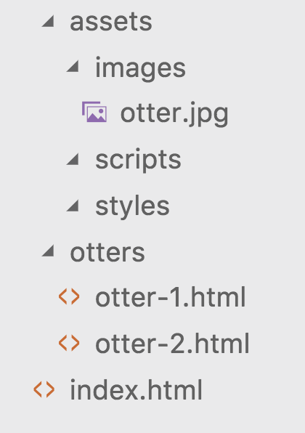
assets - Where all static resources go
images - For PNG, JPEG & most importantly GIF
otter.jpg
scripts - Where JavaScript files are
styles - Where CSS files are
otters - Sub-directory here for better structure
otter-1.html
otter-2.html
index.html - The entry HTML file
Example website structure

Slide 18
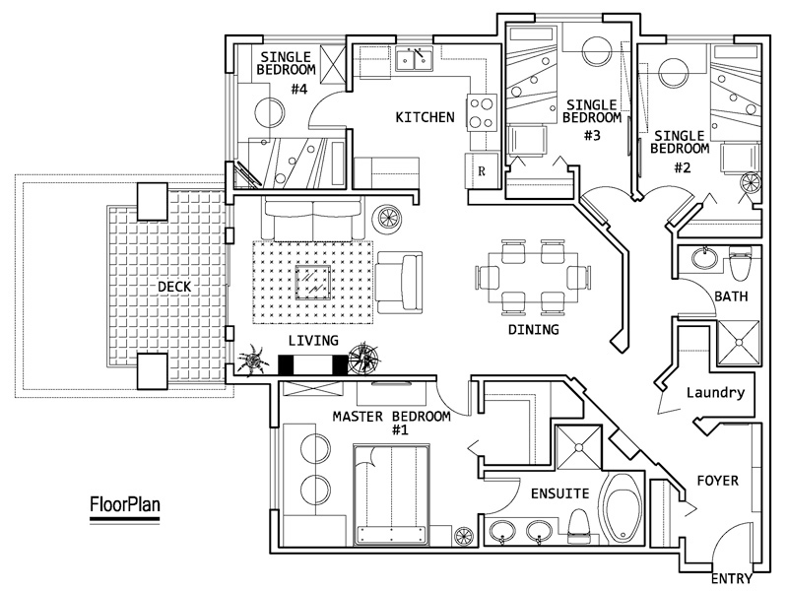
Pop quiz on how to read a floor plan
Notes:
PC: http://www.uvrentsline.com/vancouver-bc/apartment/shared-ubc-campus-gallery16944

Slide 19
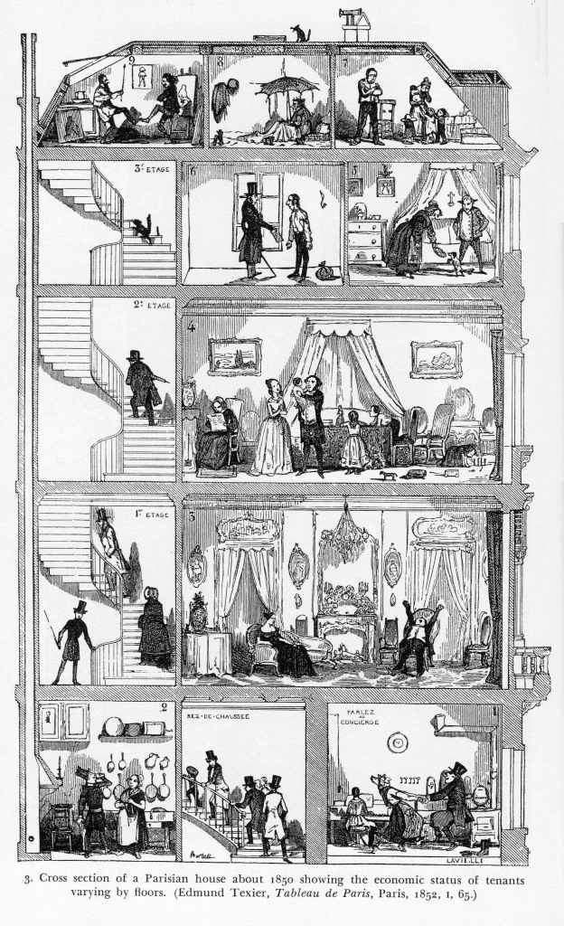
Pop quiz on how to read a floor plan
Notes:
PC: http://www.uvrentsline.com/vancouver-bc/apartment/shared-ubc-campus-gallery16944

Slide 20
assets
images
otter.jpg
scripts
styles
otters
otter-1.html
otter-2.html
index.html
<!doctype html>
<html>
<head></head>
<body>
<h1>Monterey Bay Museum</h1>
<p>Come to see the otters!</p>
<ul>
<li><a href="otters/otter-1.html">Otter 1</a></li>
<li><a href="otters/otter-2.html">Otter 2</a></li>
</ul>
<img src="assets/images/otter.jpg" width="200" />
</body>
</html>
2
3
1
1
2
3
index.html
Relative path from index.html to assets/images/otter.jpg

Slide 21
assets
images
otter.jpg
scripts
styles
otters
otter-1.html
otter-2.html
index.html
<!doctype html>
<html>
<head></head>
<body>
<a href="../index.html">Back to Home</a>
<h1>Monterey Bay Museum</h1>
<h2>Otter 1</h2>
<p>Otter 1 looks just like otter 2.</p>
<img src="../assets/images/otter.jpg" width="200" />
</body>
</html>
3
4
2
1
1
2
3
4
otters/otter-1.html
Relative path from otters/otter-1.html to assets/images/otter.jpg

Slide 22
We usually prefer relative paths to absolute paths;
sometimes we prefer absolute to relative paths

Slide 24
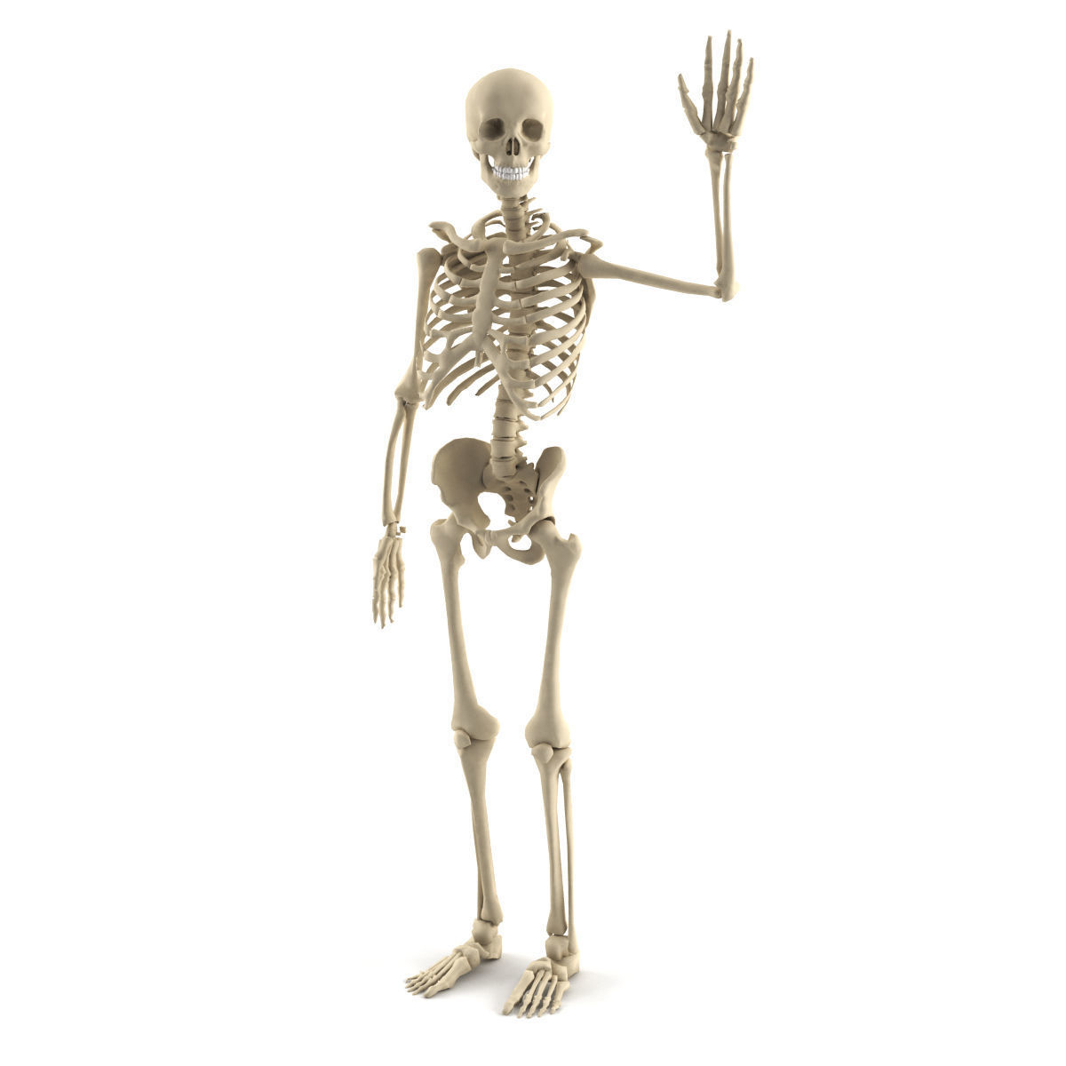
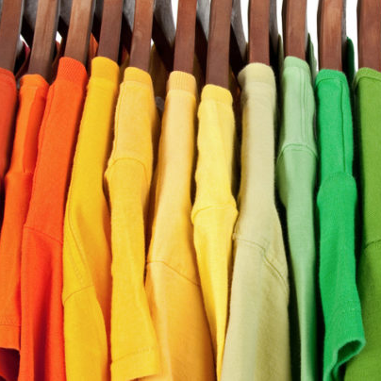

Nice we’re at the halfway point
HTML
Structure
CSS
Design
JavaScript
Function

Slide 25
Files and Linking CSS
CSS Syntax
CSS Selectors
Pseudo-Selectors

Slide 26
Files and Linking CSS
CSS Syntax
CSS Selectors
Pseudo-Selectors

Slide 27
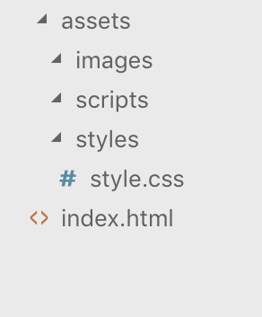
Linking CSS in HTML
How will the HTML file know where to find its stylin’ ?!
Inside the <head> tag, add this line:
<link rel="stylesheet" type="text/css" href="assets/styles/style.css">
*No need to memorize this — I’d just copy and paste or something like that
Where our CSS file will live (for this class): assets/styles/style.css

Slide 29
Files and Linking CSS
CSS Syntax
CSS Selectors
Pseudo-Selectors

Slide 30
HTML and CSS: At a Glance
<!doctype html>
<html>
<head>...</head>
<body>
<p>Welcome to WDD!</p>
<img src=”wdd.png” />
</body>
</html>
body {
width: 200px;
text-align: center;
}
p {
font-size: 32px;
color: green;
font-family: Karla;
}
HTML
CSS

Slide 31
Selectors
Tells us what elements in the HTML to “select”, or apply these properties to.
In this case, we are selecting all the div elements.
Lots of ways to specify what to select! Very powerful
div {
font-size: 32px;
color: green;
}
CSS
Notes:
Common mistake: “color” represents font color, while background color is represented by “background-color” or simply “background” as an abbreviation.

Slide 32
Property and Value
Property Defines what we are changing about the selected element
Value Specifies how we are changing it, or what it should be changed to
Together: Declaration (or rule)
div {
font-size: 32px;
color: green;
}
CSS

Slide 33
Miscellaneous, Very Small Things
Rules (property and attribute pairs) for a selector fall between curly braces
Rules with curly braces are separated by a semicolon
Comments surrounded by /* and */
div {
font-size: 32px;
color: green;
}
img {
/* This is a comment */
width: 50%;
}
CSS
Notes:
Will probably skim over this super quickly, more of a reference/review type of slide

Slide 35
Files and Linking CSS
CSS Syntax
CSS Selectors
Pseudo-Selectors

Slide 36
Disaster, what??
<p>Green text</p>
<p>Blue text</p>
<p>And more green text!</p>
/* ¡DOES NOT WORK! */
p {
color: green;
color: blue;
}
HTML
CSS
Notes:
Why a disaster? Because our selector is too general — it doesn’t allow us to specify between these two separate p tags..

Slide 37
An Attempt
<p>Green text</p>
<div>Blue text</div>
<p>And more green text!</p>
p {
color: green;
}
div {
color: blue;
}
HTML
CSS
Notes:
Technically works — but what if we run out of tags to use? We can only use one tag per “specified” thing. Also just not good for many reasons in general.

Slide 38
Yes Good
<p class=”green”>Green text</p>
<p id=”blue”>Blue text</p>
<p class=”green”>More green text!</p>
.green {
color: green;
}
#blue {
color: blue;
}
HTML
CSS

Slide 39
Classes
Apply a set of rules to multiple elements on the page
HTML: add the class attribute to opening tag
CSS: put a period in front of the class name as a selector
<p class=”green”>Green text</p>
<p class=”green”>Green text 2</p>
<div class=”green”>Also green</div>
HTML
.green {
color: green;
}
CSS

Slide 40
ID's
Apply a set of rules to only one distinct element on the page
HTML: add id attribute to opening tag
CSS: put a hashtag in front of the class name as a selector
<p id=”blue”>Blue text</p>
HTML
#blue {
color: blue;
}
CSS
Notes:
When you have conflicting rules for an element / tag that’s defined for the tag, the class, and the ID, the ID rule takes priority over the class rule, which takes priority over the tag rule. This is called specificity. The more specific the selector, the more power it has to override other rules than less specific selectors.

Slide 41
Tip for Remembering
A (student) id is unique per student.
An id is a number (#)
Many students take a class
Classes are in periods (.) in high school

Slide 42
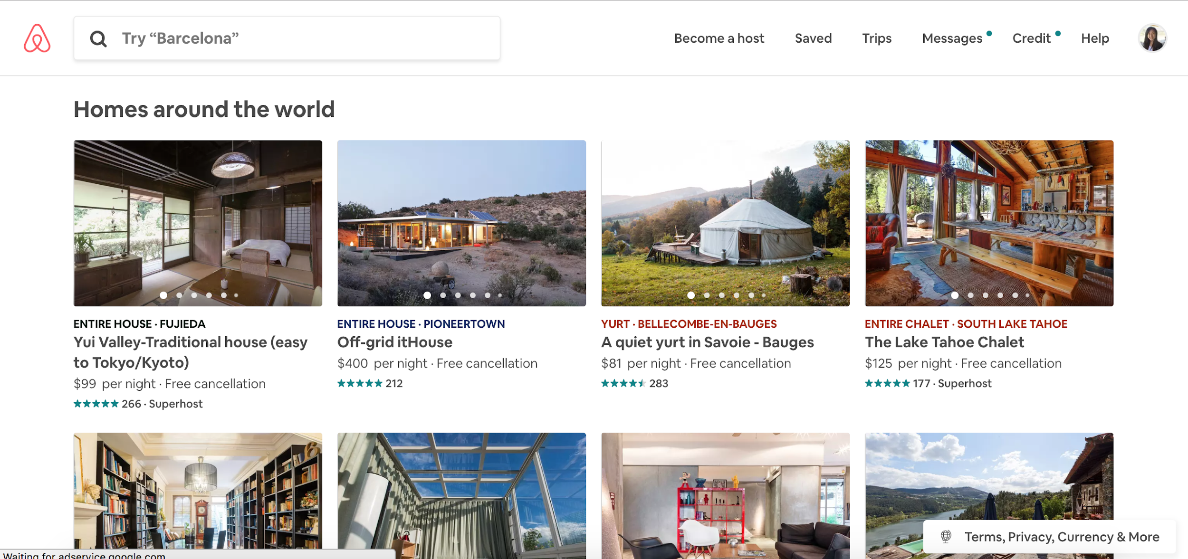
What elements might use classes? What elements might use ids?
Notes:
Airbnb.com

Slide 43

Rules of Thumb .
__% classes + __% ids

Slide 44
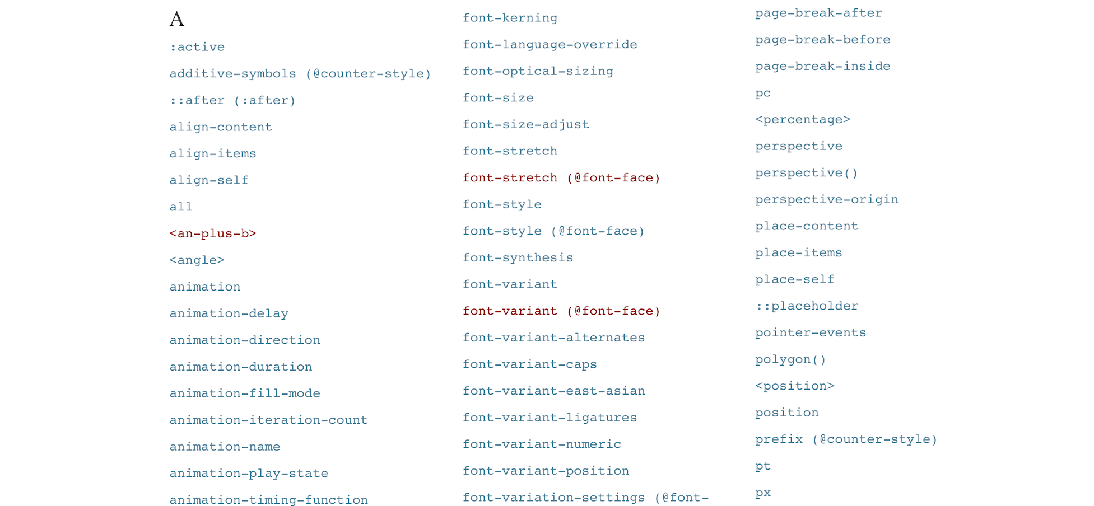
W3Schools CSS Selector Reference
Notes:
Selectors are powerful! You can chain selectors together, specify children, specify the third element, lots of cool stuff.
You’ll also have to look up some of these for homework :)

Slide 46
CSS Practice
tinyurl.com/wdd-cssbasics

Slide 47
Files and Linking CSS
CSS Syntax
CSS Selectors
Pseudo-Selectors

Slide 48
Pseudo-Selectors
Selects elements that are under a certain state
Great for user interaction

Slide 49
Pseudo-Selectors
General Pseudo-selector structure: normal-selector:pseudo-class
Rules will be applied to the div only when the cursor is hovering over
div:hover {
font-size: 32px;
color: green;
}
CSS

Slide 50
Some Pseudo-Classes
:hover
when mouse “hovers” over an element
:visited
when a link has been visited before (default is purple hyperlink)
:active
when the mouse is currently clicked on an element
… and many, many more!

Slide 51
Pseudo-Selector Practice
tinyurl.com/wdd-pseudo

Slide 53

Putting it All Together
Let’s revisit Homework 1 and make it nicer!
jsfiddle.net/r37q64Lz/

Slide 54
The End!

Slide 55
CSS Selector Game (with Sushi!)
flukeout.github.io/

Slide 56
Helpful Links
CSS Selectors
https://www.w3schools.com/cssref/css_selectors.asp
https://flukeout.github.io/
CSS Properties
https://www.w3schools.com/cssref/default.asp

Slide 57
Deep Think
Someone is bored and decides to create a new selector called family, such that the precedence between selectors is id > family > class. Why is this a bad/useless new selector? How can we use class & id to replace family?
The tie between CSS and HTML is extremely deep. So deep that we can almost construct the website using just CSS. How might we alter CSS so that using only a style.css file, we could get an accurate picture of the entire website? Why is this not a good idea in reality?
(CS) Last week we talked about how HTML was closely tied to trees, what data structure would CSS be most associated with?

